Slide 1
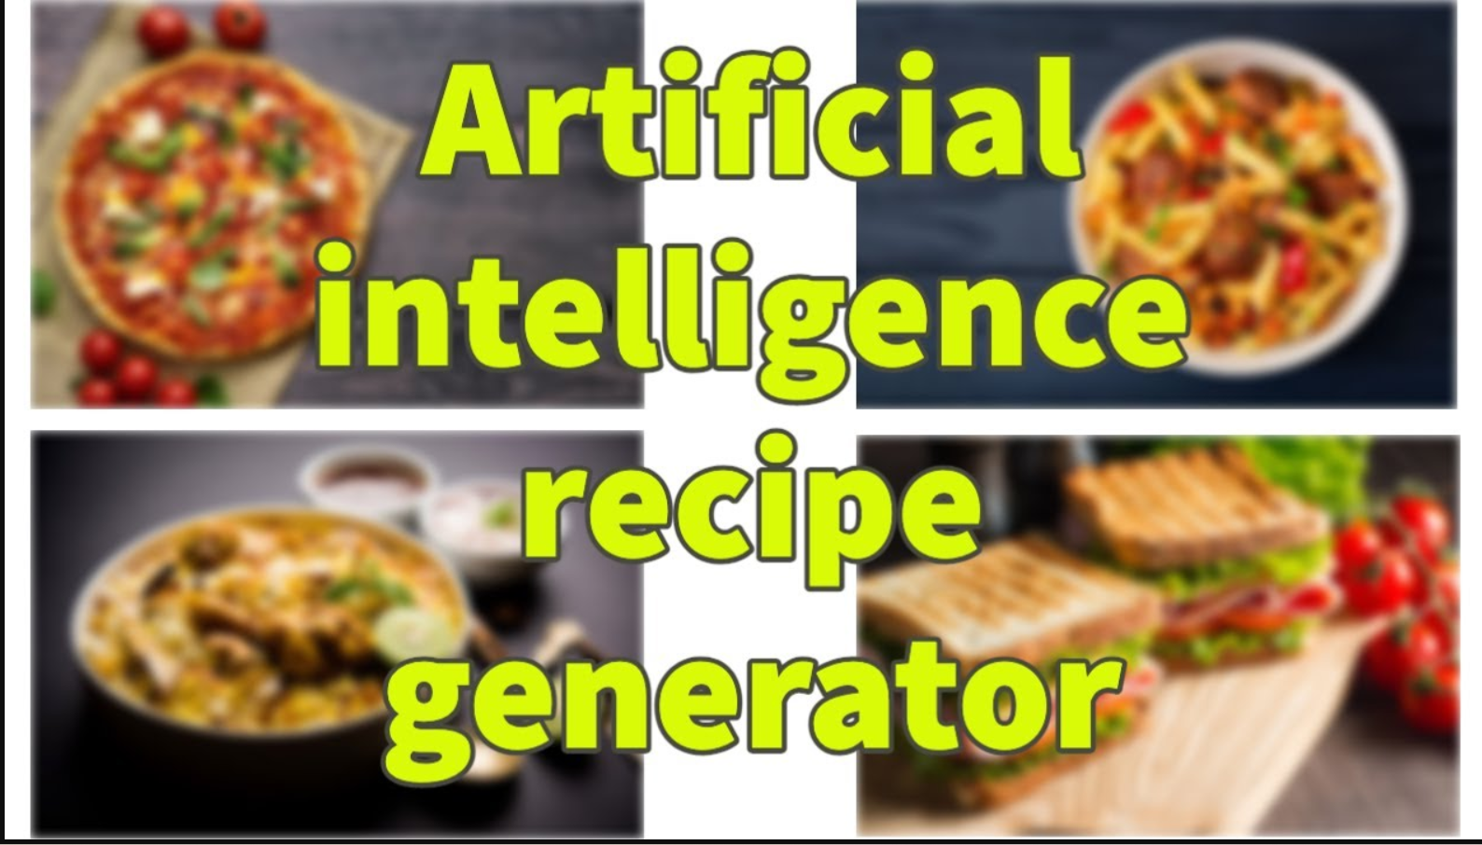

Slide 2

Problem Statement: Customized AI Kitchen - Automatic Recipe Generator
In today's fast-paced world, many people struggle with meal planning and cooking due to time constraints, lack of culinary skills, and the overwhelming number of recipe options available online.
Unique Idea brief (solution): To address this issue we propose the development of an Automatic Recipe Generator. This AI-powered solution aims to personalize and simplify the cooking experience by generating customized recipes based on user preferences, available ingredients, dietary restrictions, and nutritional goals.

Slide 3
Key Features offered:
Ingredient-Based Recipe Generation
Dietary Preferences and Restrictions
Nutritional GoalsStep-by-Step Instructions.
Meal Planning and Shopping Lists.
5.Integration with smart kitchen appliances.

Slide 4

STEPS INVOLVED IN AUTOMATIC RECIPE GENERATION

Slide 5
Start: The process begins User Query: The user inputs a query for a recipe or food item. Query Processing: The system processes the user query to understand the request. Check Cache: The system checks if the requested data is available in the local cache. Access Food Repository: The system sends a request to the food repository (database or API) to retrieve the necessary data Receive Data: The system receives the data from the food repository. Store in Cache: The system stores the retrieved data in the local cache for future requests. Generate Response: The system processes the data and generates a response for the user. Send Response: The system sends the response to the user. End: The process ends

Slide 6
ARCHITECTURAL FRAMEWORK AND WORKING DESIGNS

Slide 7
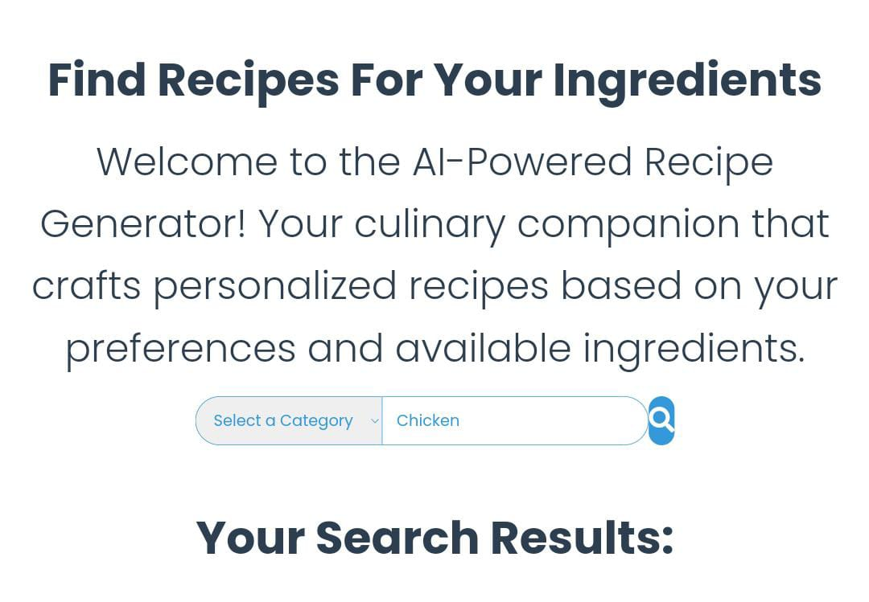
PROBLEM STATEMENT

Slide 8
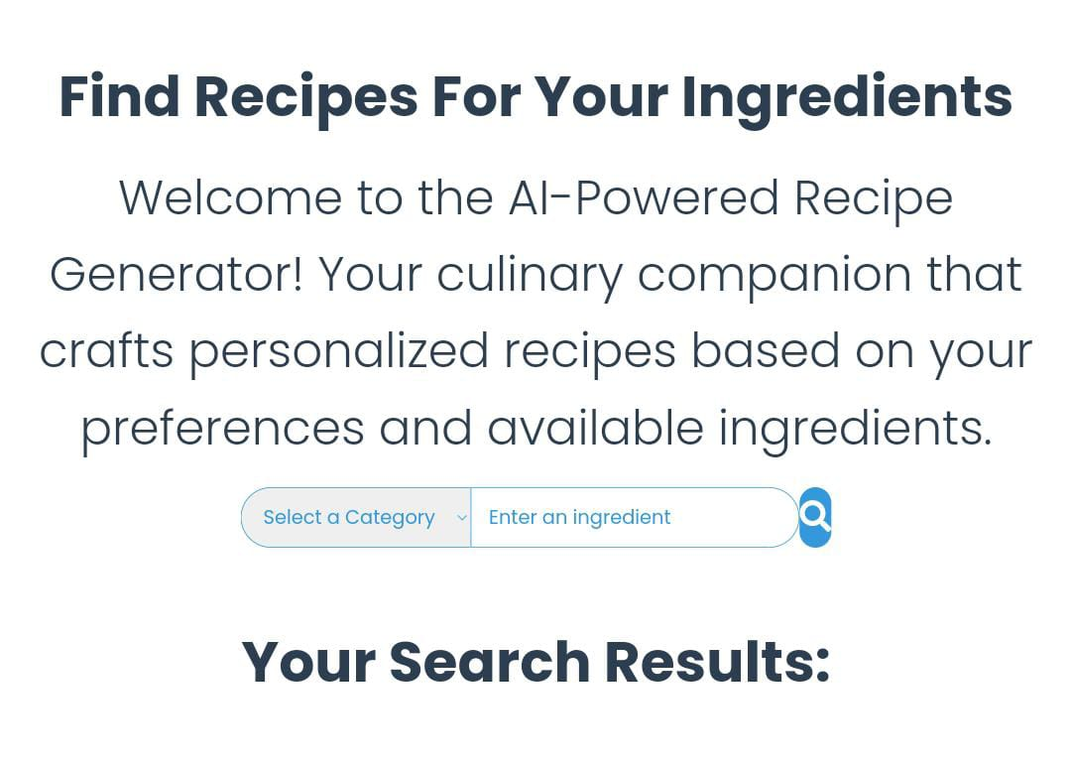
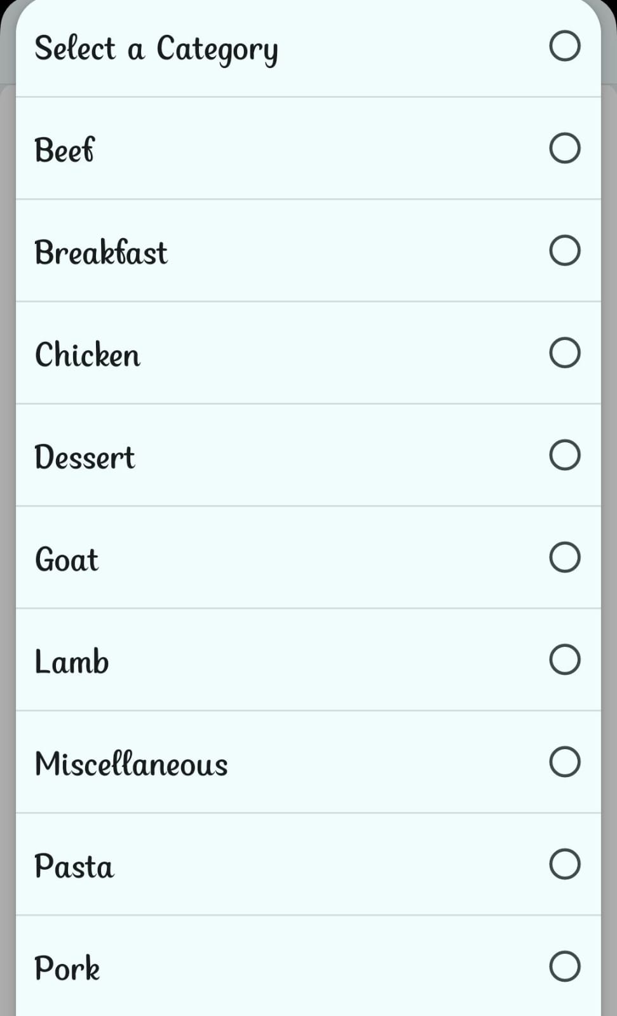


Slide 9
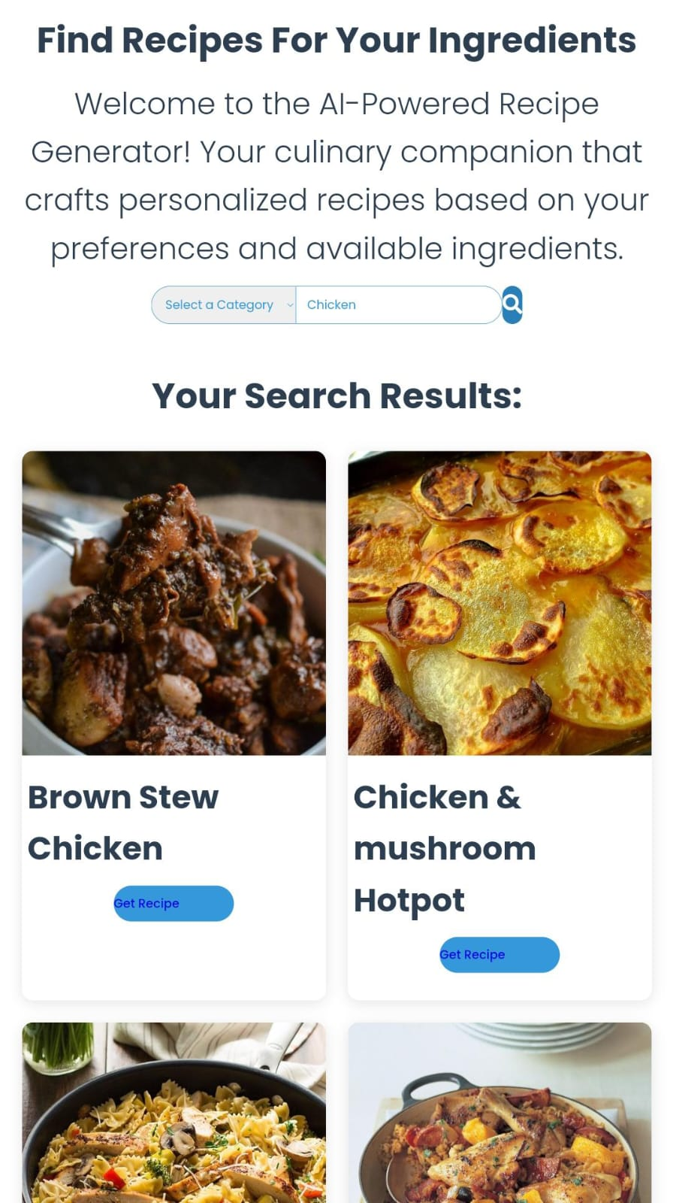
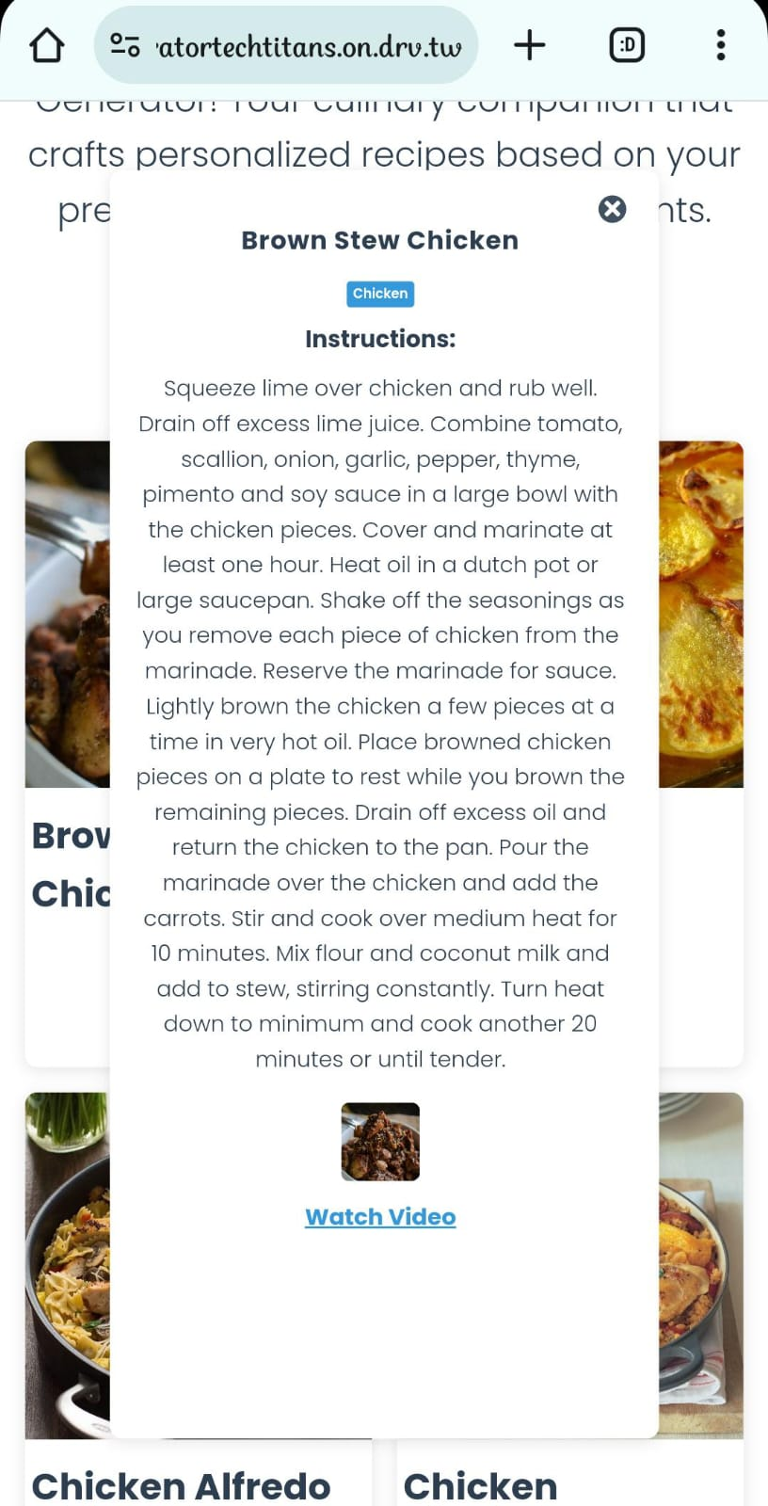

Slide 10
ARCHITECTURAL FLOW DIAGRAM:
QUERY PROCESSING AND VERYFING CACHE
RECEVING AND STORING THE DATA IN THE MEMORY
USER QUERY
ACCESSING FOOD REPOSITORY
OR
DATA BASE, Data WAREHOUSE VERYFING
GENERATING THE RESPONSE
TRANSFERING THE RESPONSE
USER ACCESSING THE DATA

Slide 11
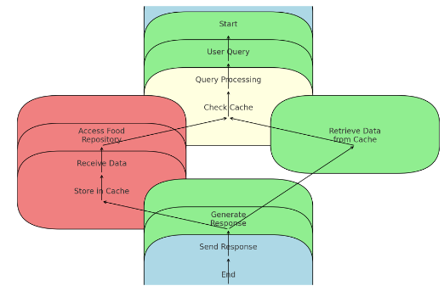
PROCESS FLOW:

Slide 12
TECHNOLOGIES USED :
The AI-Powered Recipe Generator uses modern web technologies to create a robust and user-friendly experience. Here’s a brief overview of the key technologies:
HTML (Hyper Text Markup Language):
Provides the structure and content of the web pages.
Defines layout elements like headings, paragraphs, buttons, and input fields.
CSS (Cascading Style Sheets):
Styles the HTML elements for a cohesive look.
Uses customised styles.
Employs media queries for responsive design across all devices.
JavaScript:
Adds interactivity and dynamic functionality.
Handles events, fetches data from APIs, and updates the DOM to display search results and recipe details.

Slide 13
ANALYSIS AND OBSERVATION ON AUTOMATIC RECIPE GENERATOR

Slide 14

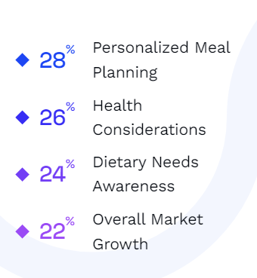
PIE CHART:
So this is an data representation of how the market trends varies based on user requirements and market demand for automatic recipe generator . And also every user needs varies so this chart give idea of what different users focuses on when it comes to food and its products

Slide 15
SWOT ANALYSIS FOR AUTOMATIC RECIPE GENERATOR
S
W
O
T
Personalization , efficiency ,health benefits
Theis recipe generator gives personalized recipes and cooking process in step by step process
Dependency on accurate data , complexity of algorithms
It includes challenges like the need of precise data as input and complexity in developing algorithms
Smart kitchen integration and expansion leads to new innovation
There are various opportunities that exist like integration of this application with smart kitchen appliances
Privacy concerns and technological limitations
It includes user data so there may be privacy issues and full potential is not achieved by the application

Slide 16
TEAM MEMBERS AND CONTRIBUTIONS :
Team Members:
1. KOWSHIK- Team Lead and Front end Developer
2. THOUFIQ AHAMED .A- Back end Developer Lead
3. DHANUSRI.T - Project Managing Lead and Documentation Assist
4. ANISH FATHIMA.N - Documentation Lead and Testing
Faculty Mentor :
1. P.VALARMATHI

Slide 17
CONCLUSION:
So in this way the concept of our automatic recipe generator supports the concept of customised AI-KITCHEN and makes the process of cooking easier and efficiently supports the user’s cooking methods and it values each of it’s individual user requirement’s and make a change in the cooking methods by its techniques and gives a user friendly experience to its users

Slide 18
THANK YOU

